Slide 1
TRAVEL WEBSITE

Slide 2
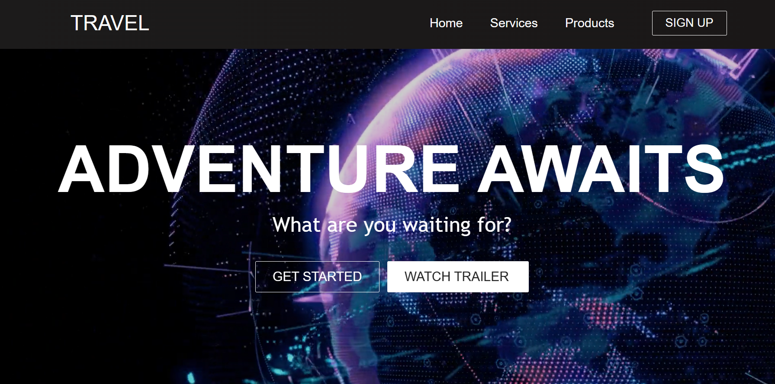
1
https://monika-sharma1234.github.io/Travel-And-Tour-Website/

Slide 3
LANGUAGES USED
2
HTML – HTML stands for Hypertext Markup Language. It is used for creating web pages and web applications.
CSS - CSS stands for Cascading Style Sheets. It is a style sheet language which is used to describe the look and formatting of a document written in markup language.
JavaScript - It is a scripting language used to create and control dynamic website content, i.e. anything that moves, refreshes, etc.
React Js. React is a library. It lets you put components together, but it doesn’t prescribe how to do routing and data fetching

Slide 4
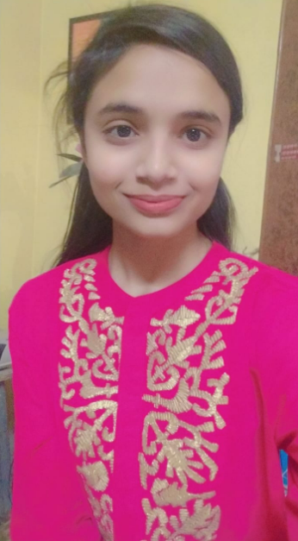
PROJECT MEMBER
3
Monika Sharma (201500410)

Slide 5
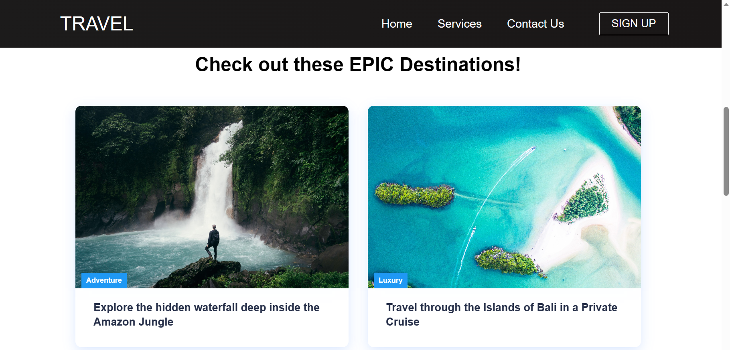
Popular Destinations
4

Slide 6
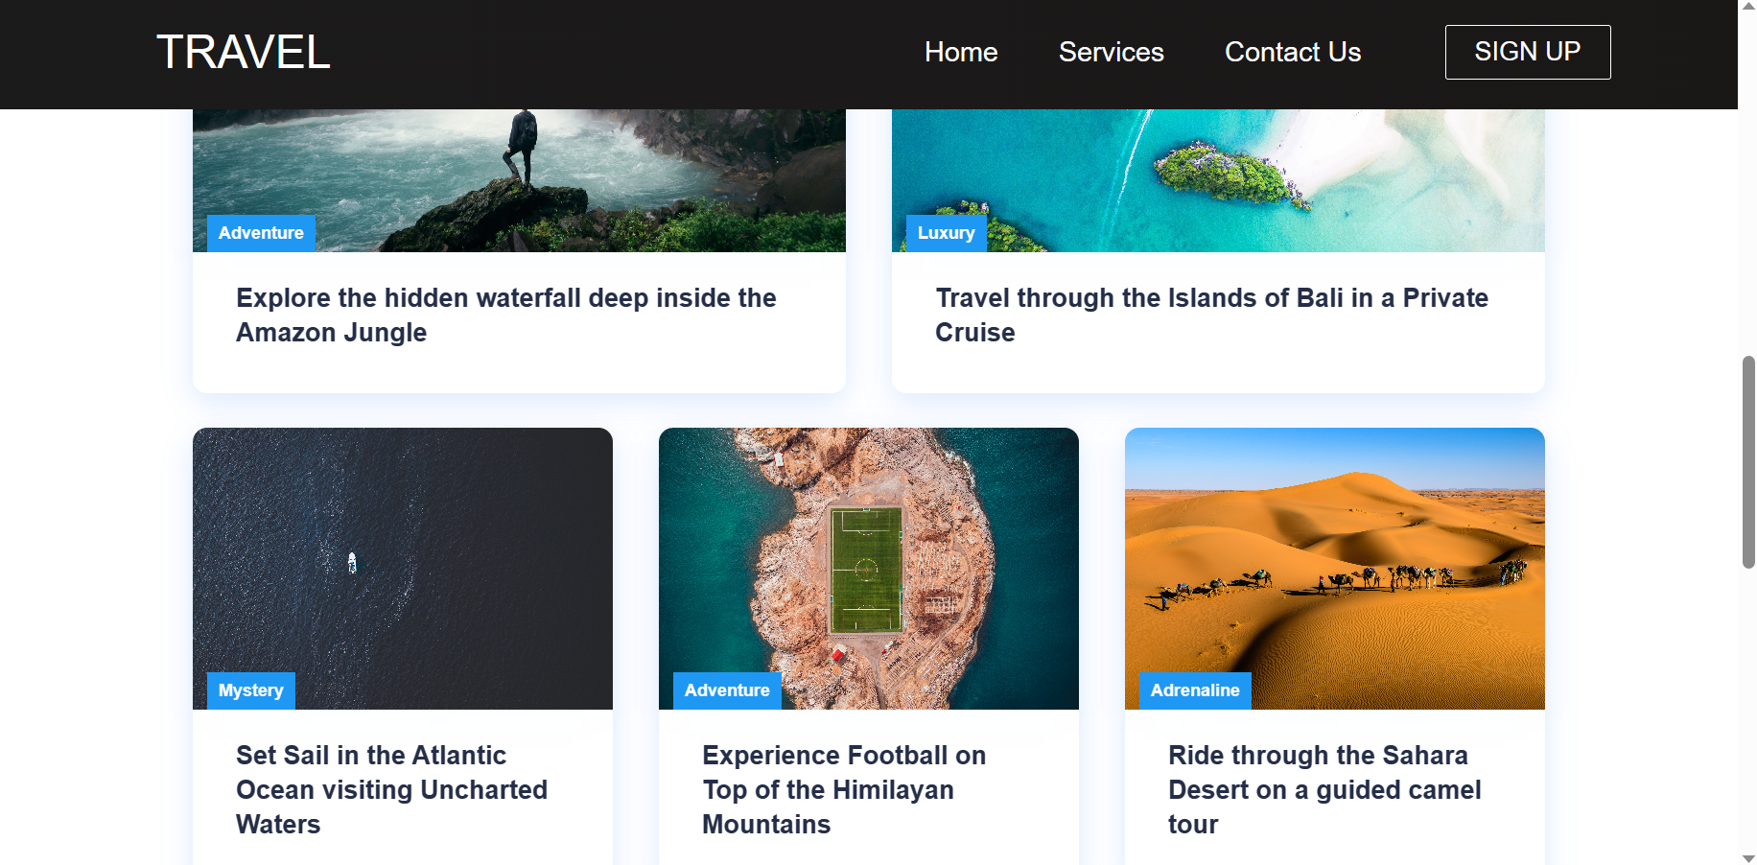
Destination

Slide 7
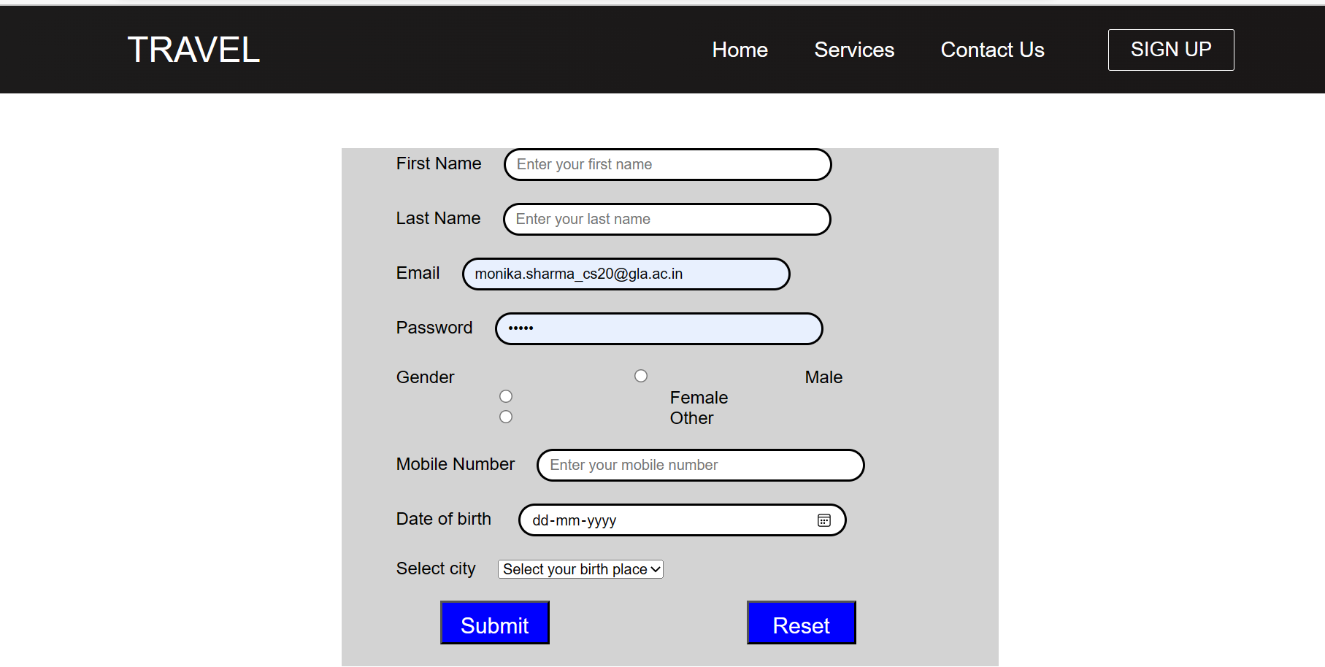
5
SignUp Page

Slide 8
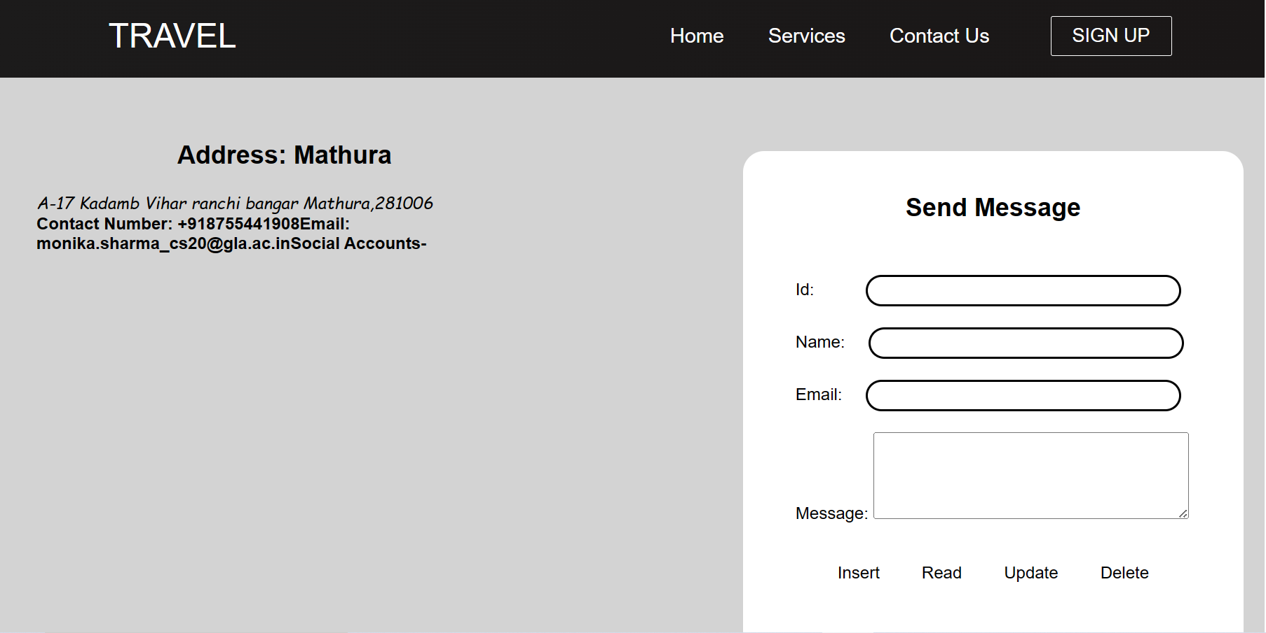
6
Contact Us

Slide 9
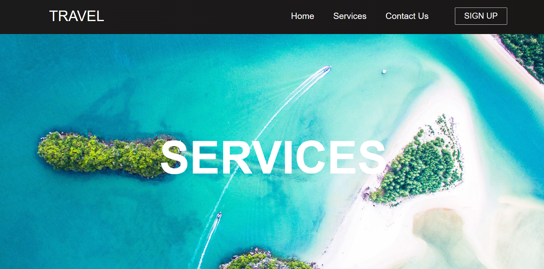
7
Services

Slide 10
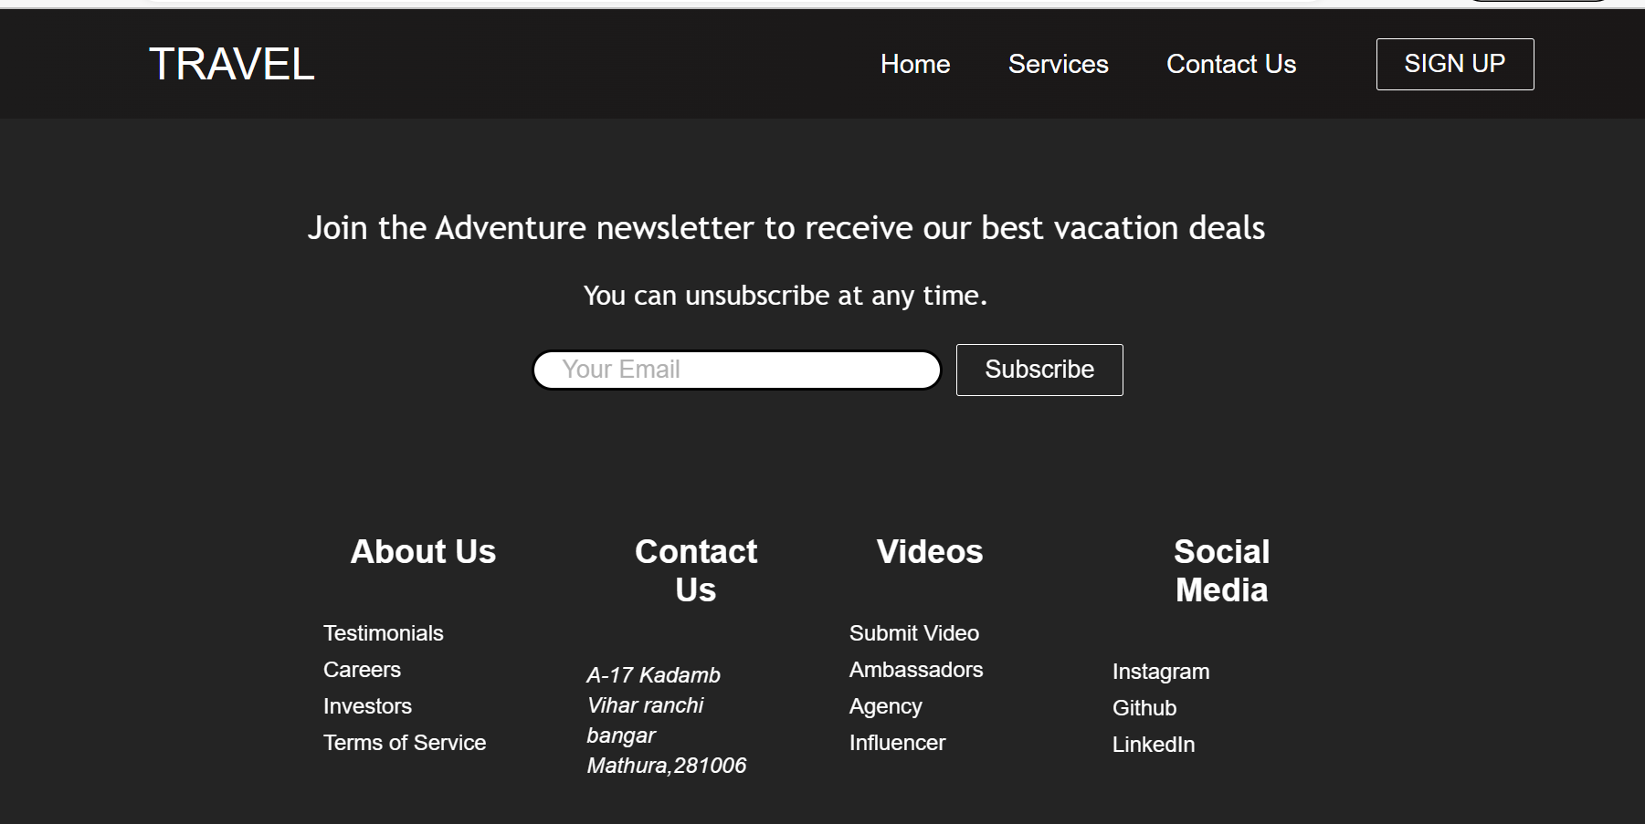
8
Footer

Slide 11

Term of Services
9

Slide 12
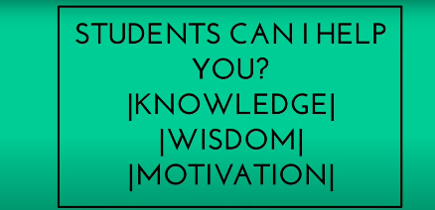
Career in Travel
11

Slide 13
THANK YOU
15
https://monika-sharma1234.github.io/Travel-And-Tour-Website

